Slide 1
Paris 2024 Communications Experience
iCERT Fall Meeting
November 2024
Smart communications for public safety & industry

Slide 2
Looking Back at Paris 2024
My vantage point
Top challenges
Reflections on Paris comms
Takeaways

Slide 3
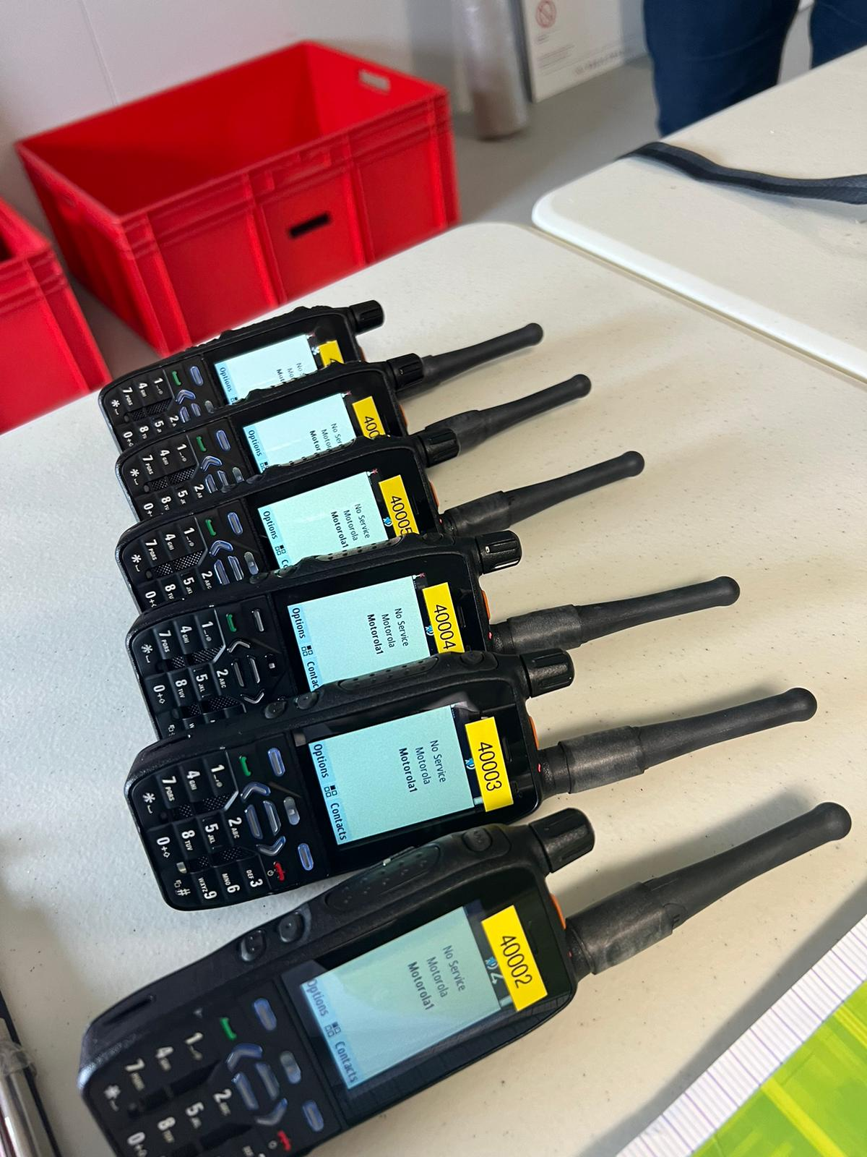
Seven Weeks in Paris
Delivery Partner: Riedel Communications Team
Contract: Deliver TETRA PTT for security functional areas at 21 venues and villages
Build and operate TETRA base stations at venues
Supply Motorola MXP600 UHF portables with Olympic fleet map for security function
Supply Motorola Wave terminals for Toyota fleet operations

Slide 4
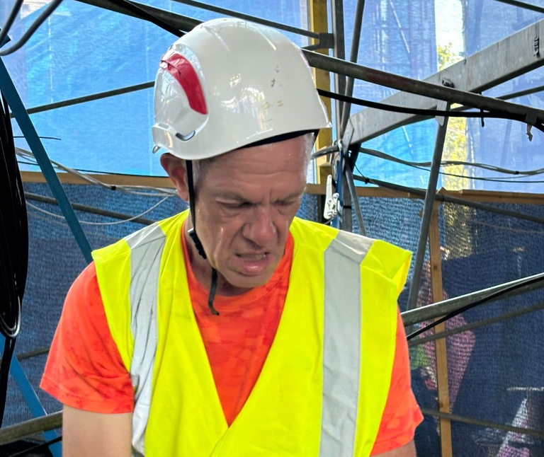
Seven Weeks in Paris
My perspective: Working on the Riedel support team
Deliver devices
Assist base station installation
Monitor base stations and troubleshoot failures
Assist venue staff with communication questions and problems

Slide 5
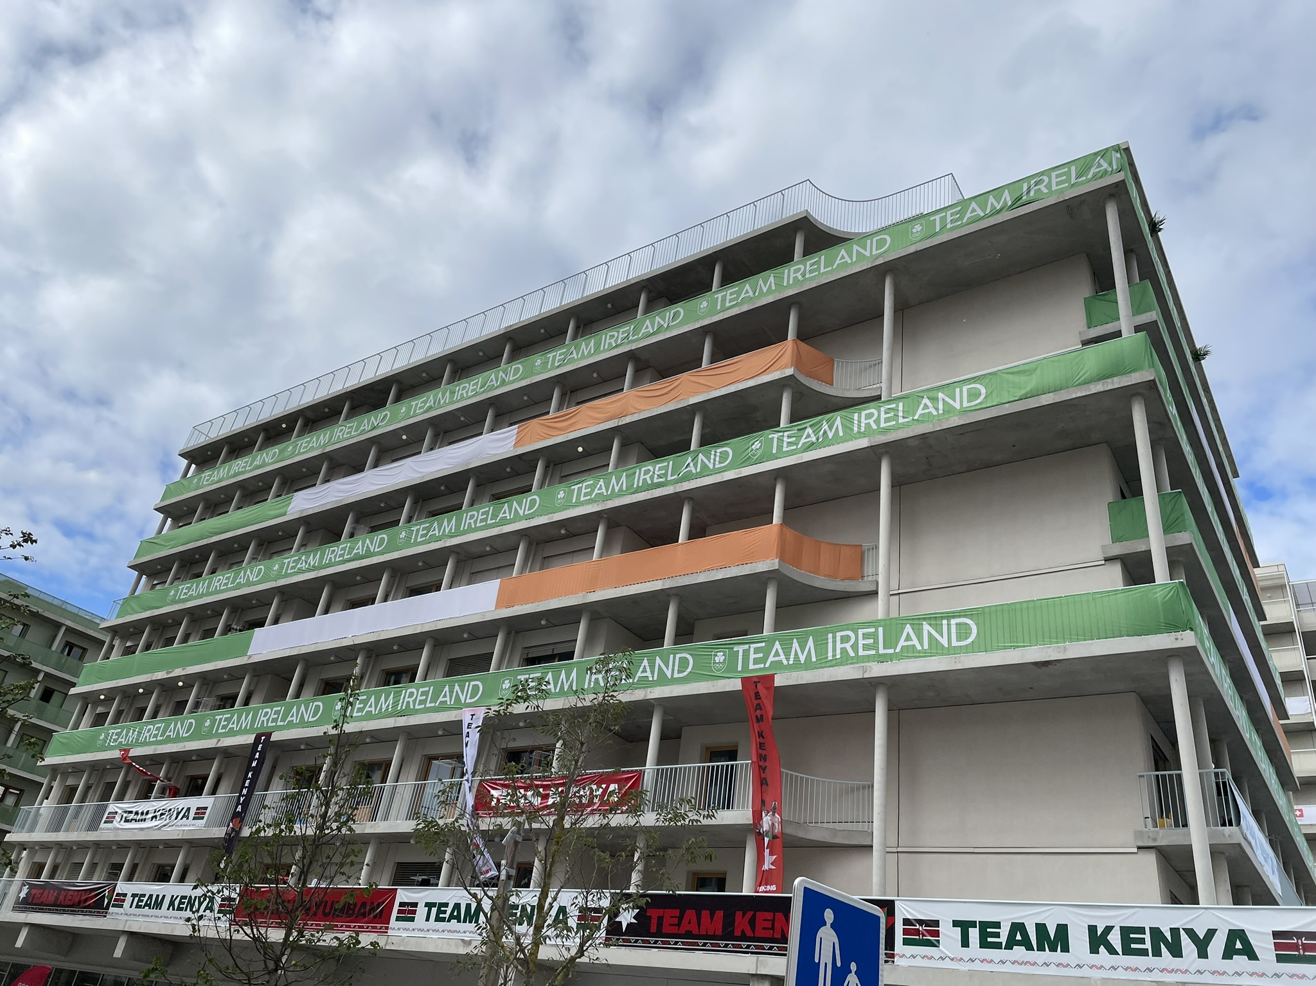
Seven Weeks in Paris
My Opportunity: Wander the city and the venues
Observe the venue operations model
Observe the interplay of communications technology
PTToC
MCPTT
Sport timing systems
C-UAS systems
Diplomatic security protection for Heads of State
First Responder communications

Slide 6
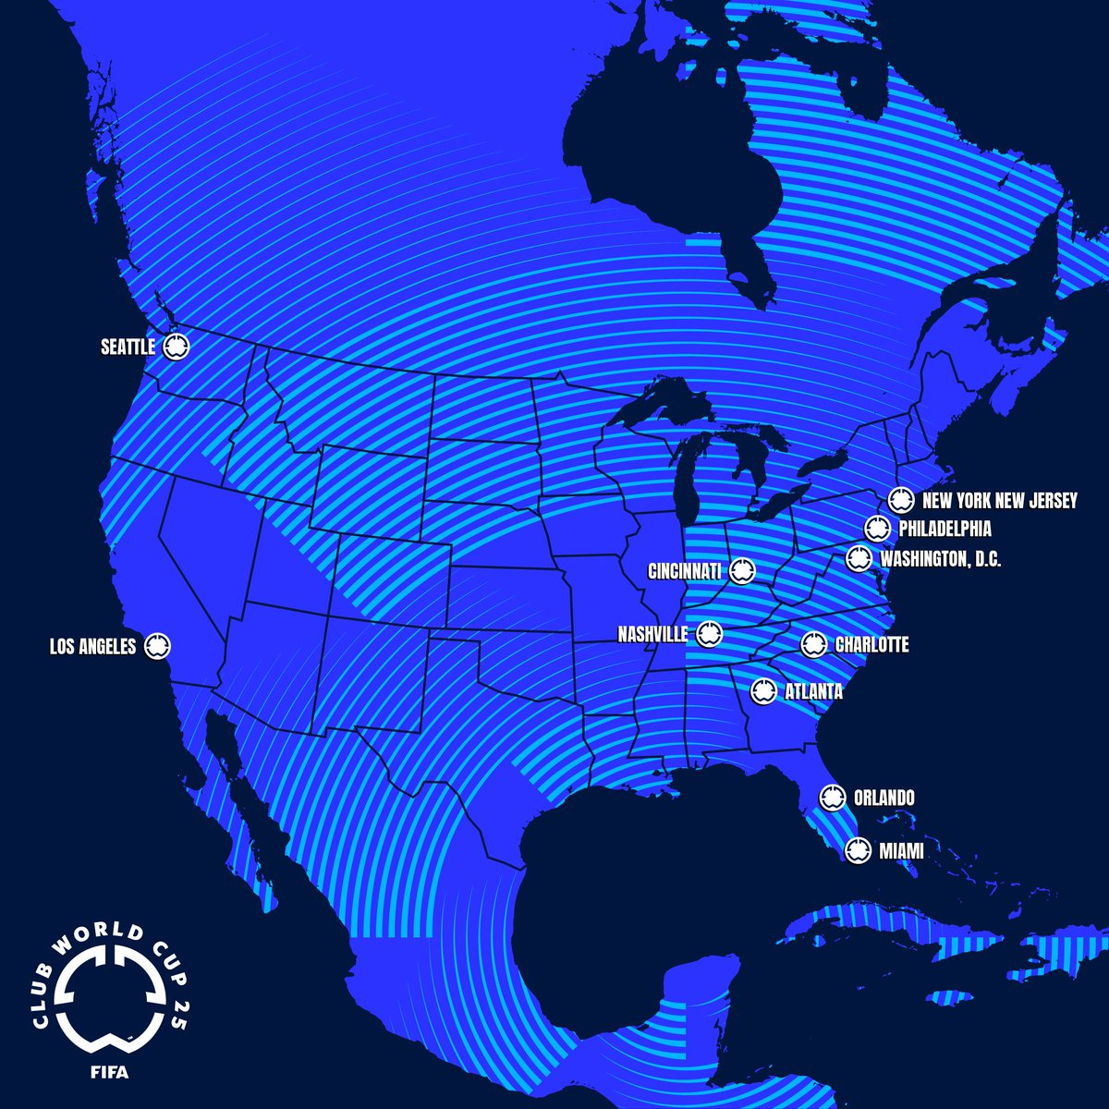
Why Should You Care?
North America is about to get busy
FIFA Club World Cup - 2025
FIFA World Cup - 2026
Los Angeles Olympic and Paralympic Games 2028
Advanced planning is critical
Spectrum planning
Interoperability planning
Commercial opportunities

Slide 7
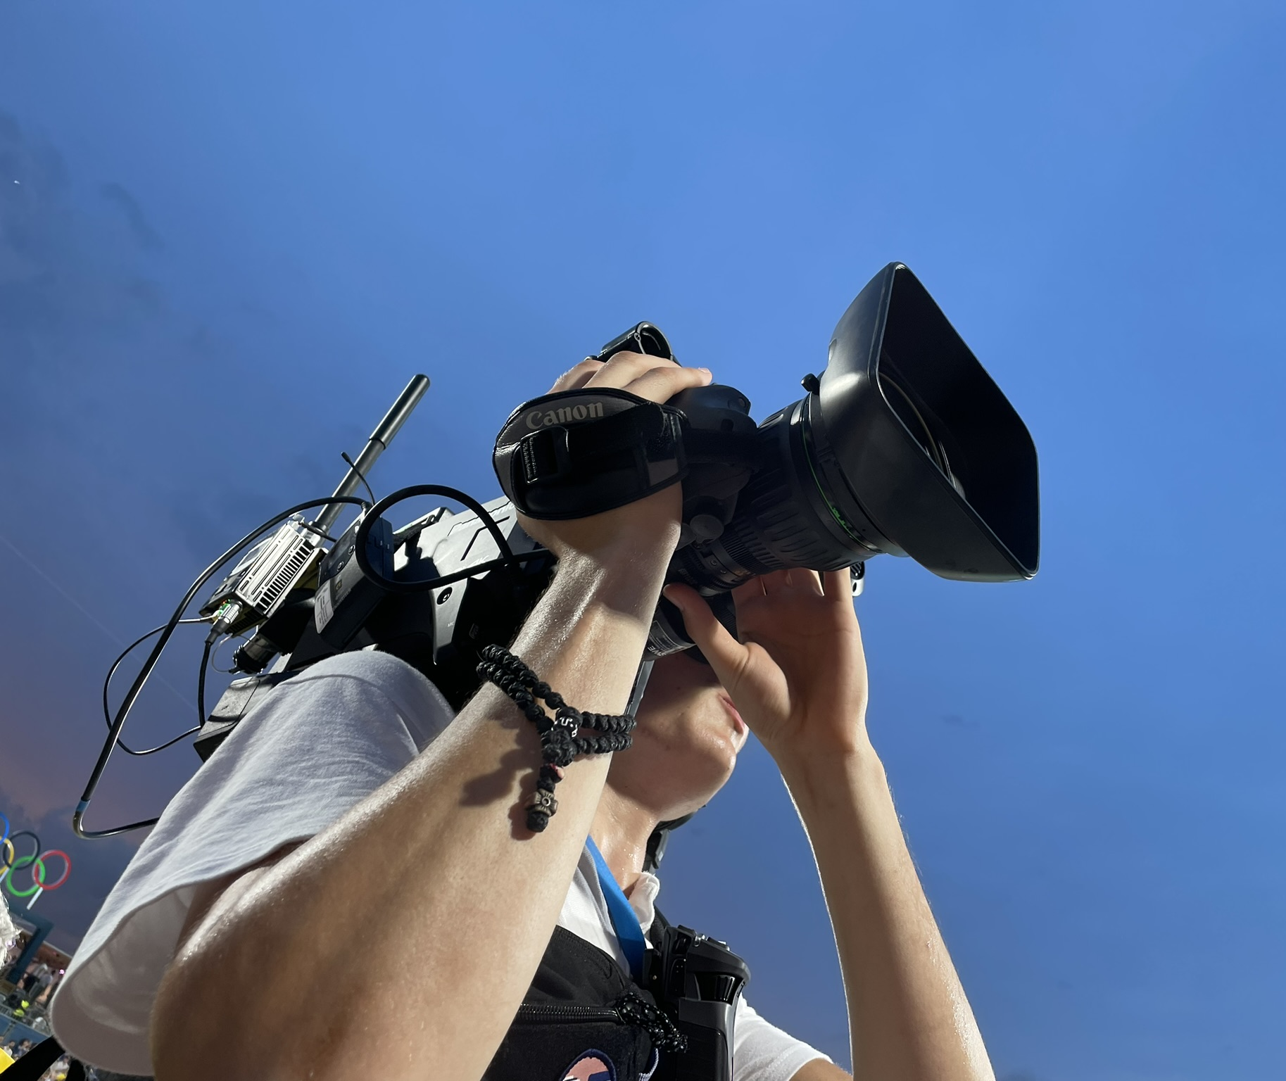
Your Amuse-bouche
30 minutes of chat does not substitute for in-depth discussions
DHS CISA ECD operating programs to link key stakeholders
Planning in-depth sessions at IWCE in Las Vegas

Slide 8
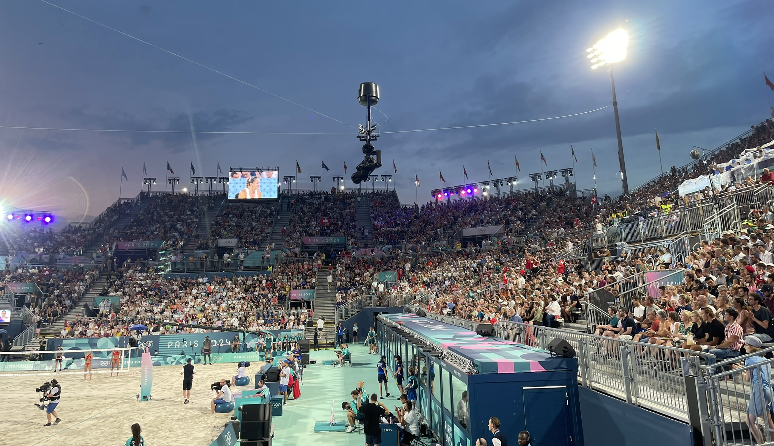
Extraordinary Scale - Sports
9.5 million tickets sold in total (out of 10 million possible)
Basketball broke prior Olympic attendance record with 1,078,319 fans
Rugby Sevens with 530,000 spectators at Stade de France
Spectrum demands for Broadcast, Venue operations, Sport operations, Performances
16,762 Frequencies for Olympic Games
6,200 Frequencies for Paralympic Games

Slide 9
Extraordinary Scale - Safety
Public safety expanded
2,185 Police officers from 46 countries
Massive temporary deployment of national police & fire personnel

Slide 10
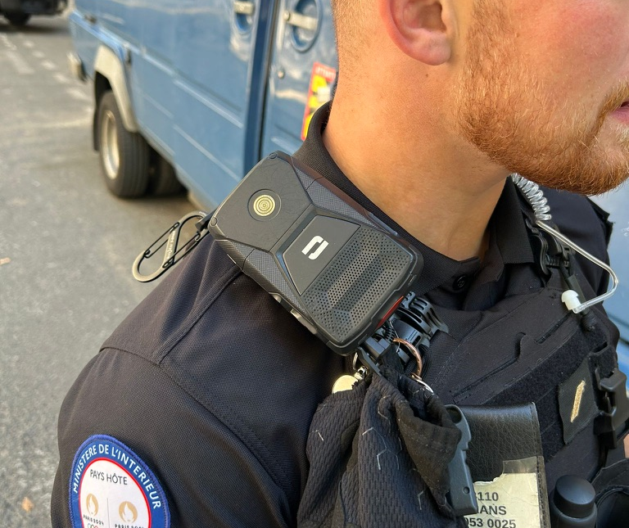
Showcase for Push-to-Talk over Cellular?
Security team had traditional LMR portables
Venue operations team used hardened smartphones with MC-PTT
Some National Police with ACMOSS devices
Staff avoided the MC-PTT
Poor physical form factor
Difficult screen user interface

Slide 11
Showcase for Push-to-Talk over Cellular?
Staff avoided the MC-PTT
Poor physical form factor
Unacceptable accessory connection
Difficult screen user interface

Slide 12
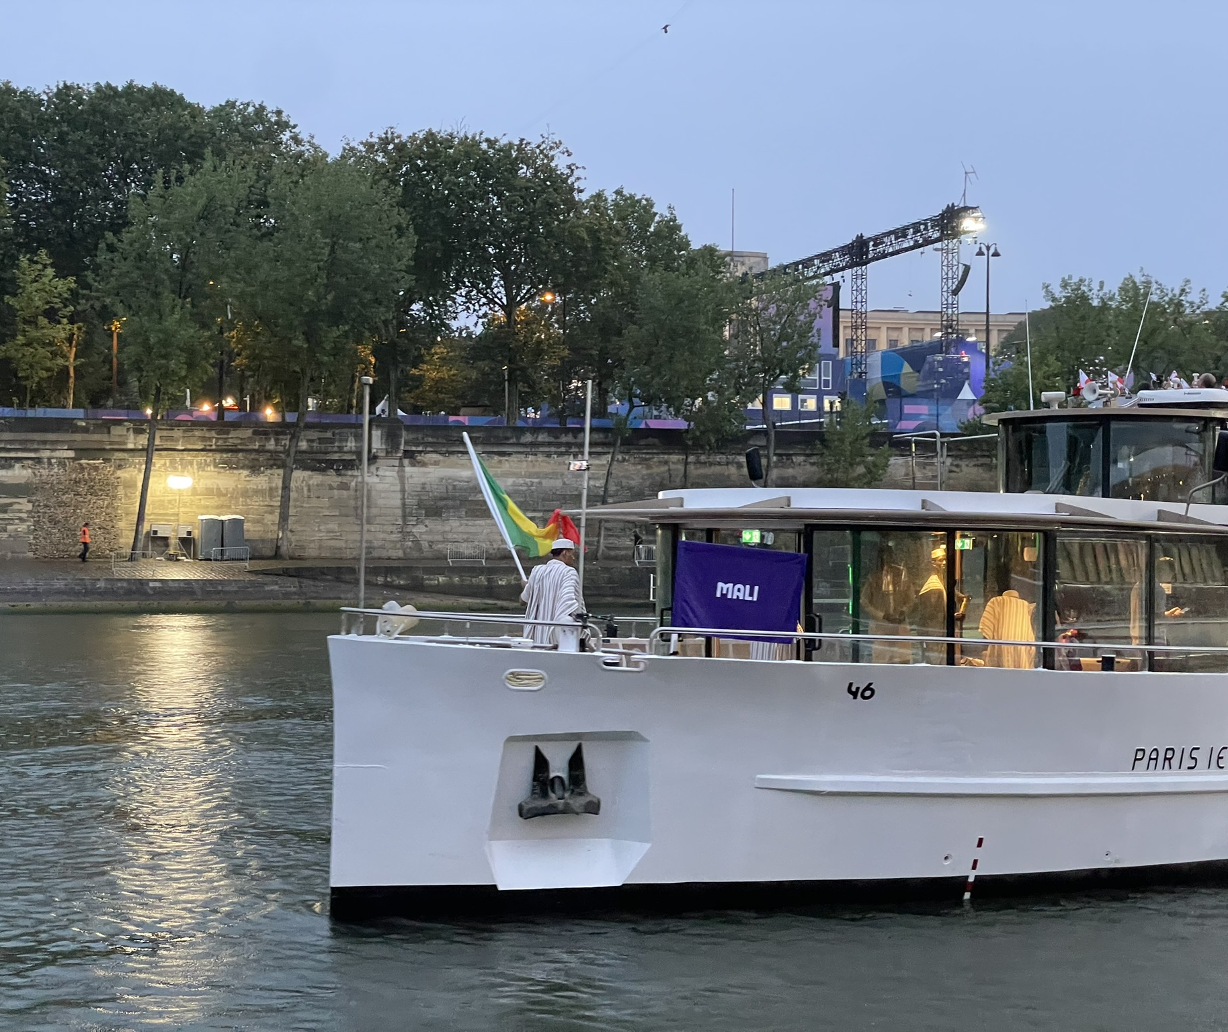
Showcase for 5G?
Primarily limited to traditional mobile broadband use
Used for Opening Ceremony boat parade
Used for sailing competition

Slide 13
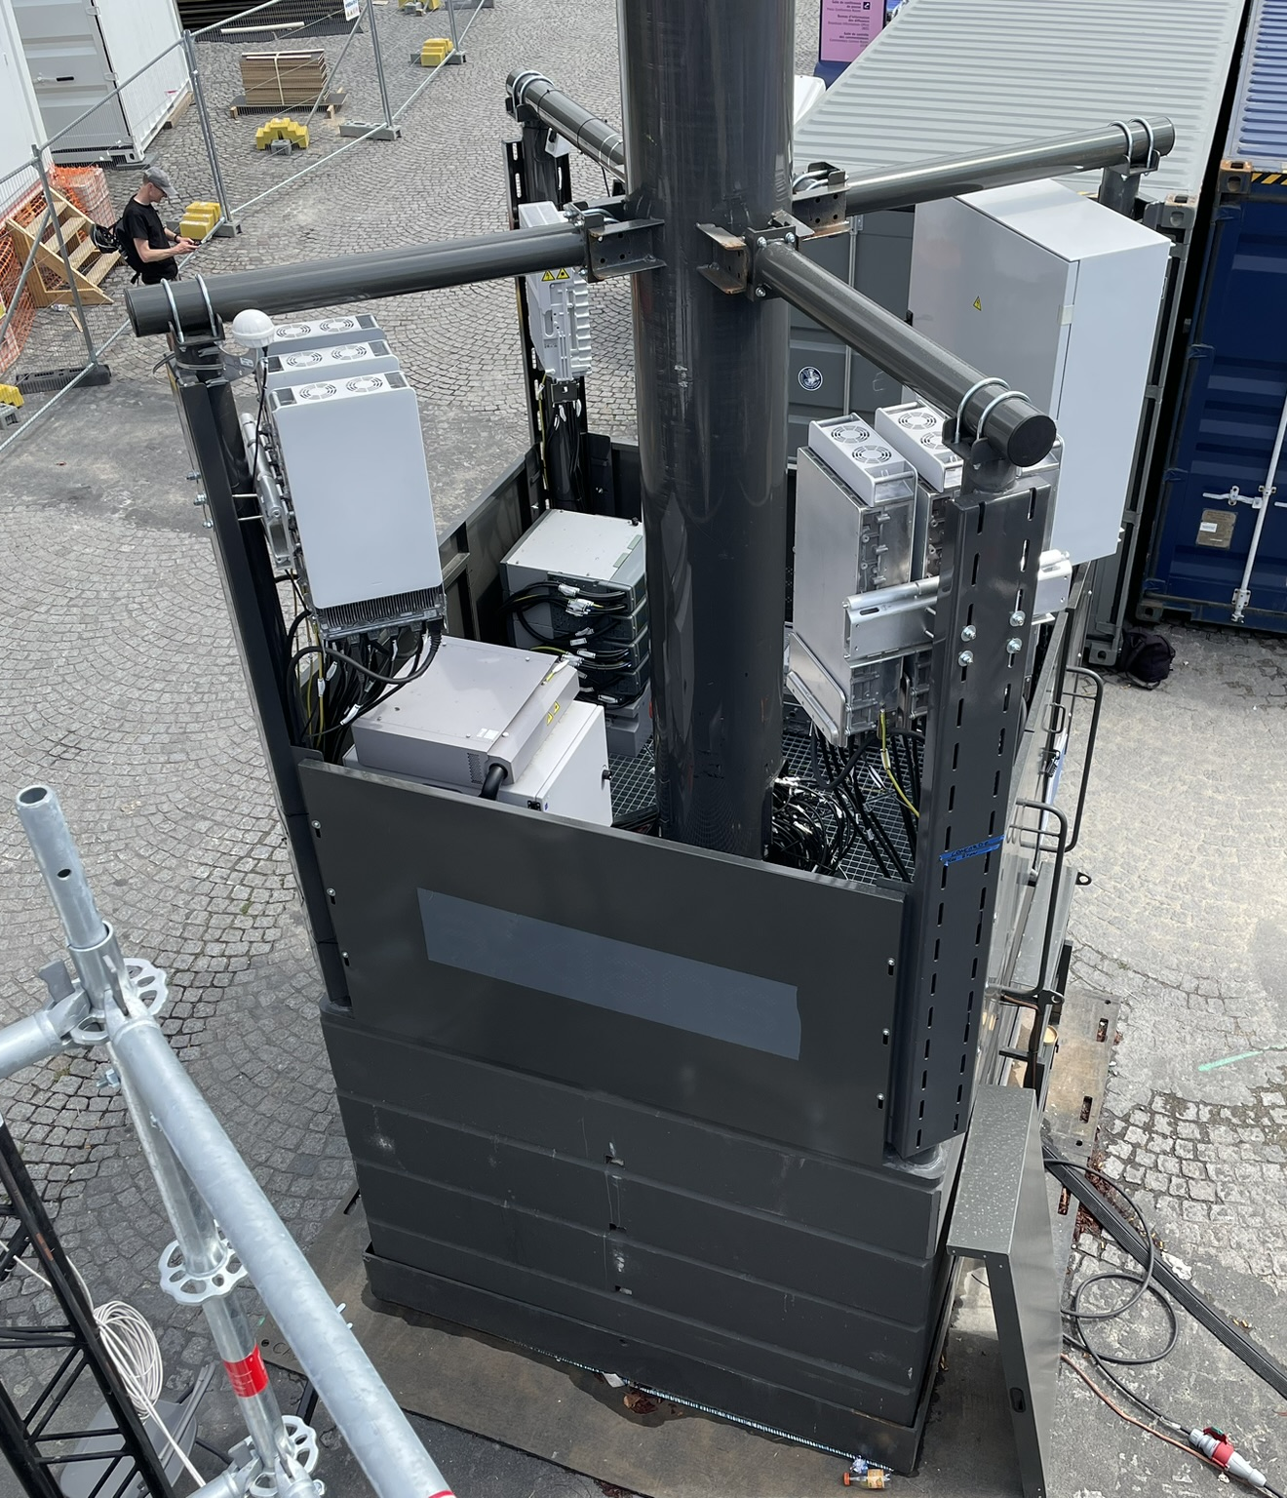
Unique Challenges
Counter UAS
Jamming by protective details
Poorly positioned temporary Cellular Towers
LED lights

Slide 14
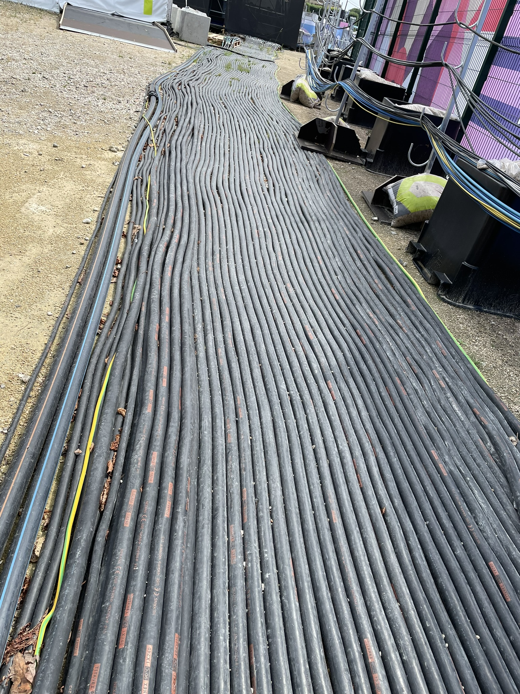
Takeaways
Plan early
MC-LTE needs more fit-for-purpose handsets that are PTT-centric
Don’t underestimate the impact of scale and stakes

Slide 15
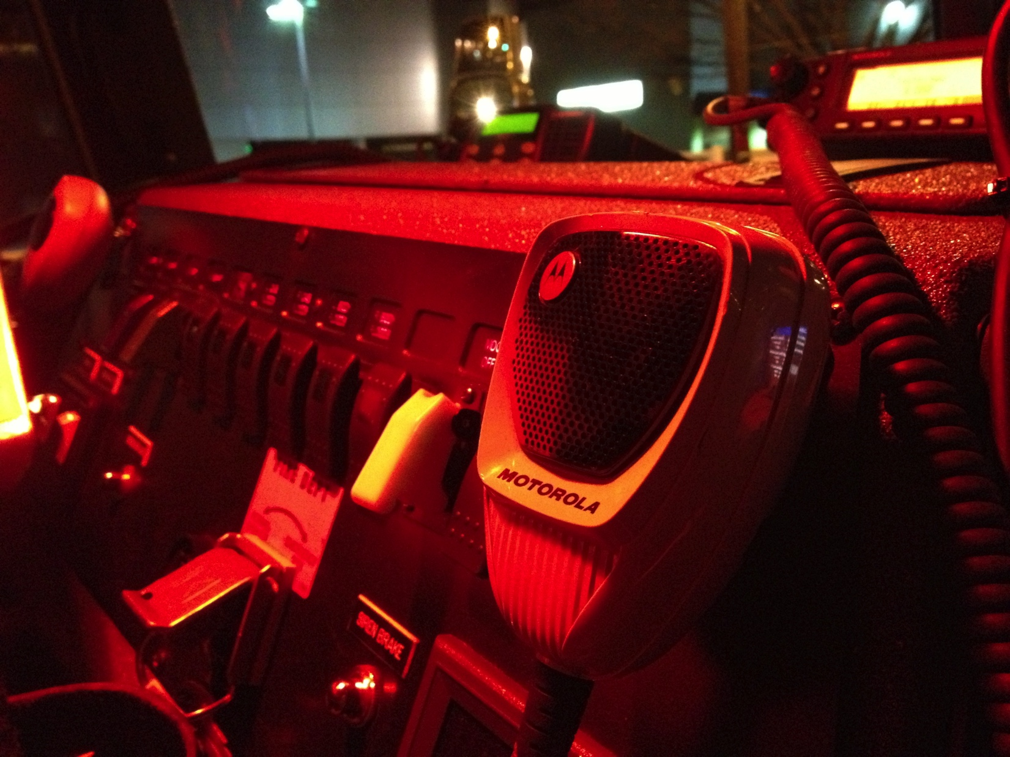
Ken Rehbehn
Principal Analyst
Email: krehbehn@critcomminsights.com

